Slide 1
Machine Learning aided Stock Market Prediction
S Project

Slide 2
Why Financial Markets?
The challenge is because of the uncertainty and volatility of the stock prices in the market.
The factors influencing the markets are numerous and complicated.
Different techniques are used to predict the price index direction with various levels of accuracy in different time-frames.

Slide 3
Why Machine Learning?
Concept of learning from the past data and predicting the outcome for an unseen/new situation, closely resembles the way humans learn.
Added advantage: Machines have the capability to process data at a much larger scale and with much larger complexity.
Trillions of gigabytes of data being generated every day, impossible to draw inferences and relations among the relevant sets.

Slide 4
Traditional Approach to Investment Analysis
Graham’s “Defensive Investor” Strategy (1949)
Adequate size of the enterprise
A sufficiently strong financial position
Earnings Stability
Dividend record
Earnings growth
Moderate Price/Earning Ratio
Moderate Ratio of Price/Assets

Slide 5
Active Trading Strategies
Day Trading : Positions are closed out within the same day they are taken, and no position is held overnight
Position Trading : Aim to benefit from both the up and downside of market movements
Swing Trading : Buying or selling as price volatility sets
Scalping : Exploiting various price gaps caused by bid-ask spreads and order flows

Slide 6
Introduction to Project
The aim of the project is to begin by analysing different techniques used for Stock Index Prediction and draw a conclusion on the performance of each technique in varied market environments.
Then we would choose a suitable algorithm for further study and development and try to pinpoint the causes of error and reduce the error factor while improving the accuracy of prediction.

Slide 7
Problem Definition
We are analysing three techniques used for Stock Index Prediction and draw a conclusion on the performance of each technique in varied market environments.
This analysis would be followed by choosing the most promising candidate and applying various selection and improvement techniques to eliminate or reduce the error factor and improve accuracy in predicting stock prices.

Slide 8
Stock Market Predictions using Artificial Neural Networks
Artificial Neural Network approach has been used to predict the adjusted closing price of the stock.
Feed forward neural network has been used for the prediction purposes.
ANNs is able to discover relationship in the input data set without a prior assumption of the knowledge of relation between the input and output data
It can be used to build a model that can identify hidden patterns in the data which can further be used for prediction purposes

Slide 9
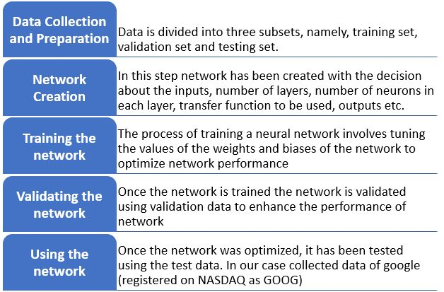
METHODOLOGY

Slide 10
Stock Market Predictions using Genetic Algorithm
Technique used is Data mining along with Genetic Algorithm
This study intends to find good sets of rules which would have made the most money over a certain historical period.
The important aspect of the GA application is the encoding of the hypothesis and evaluation function for fitness
GA operates through a simple cycle consisting of four stages: initialization, selection, crossover, mutation
The main idea of GA is to start with a population of solutions to a problem and attempt to produce new generations of solutions which are better than previous ones.

Slide 11
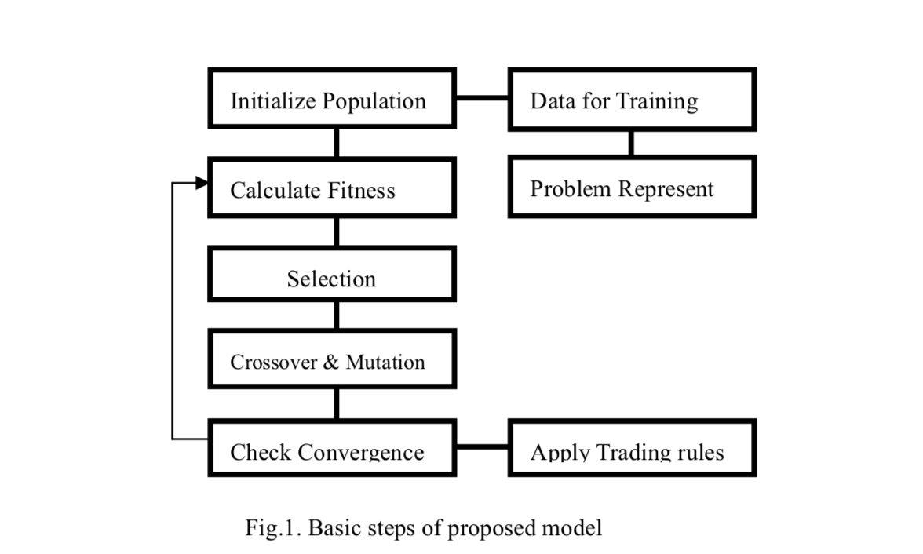
Stock Market Predictions using Genetic Algorithm
Algorithm

Slide 12
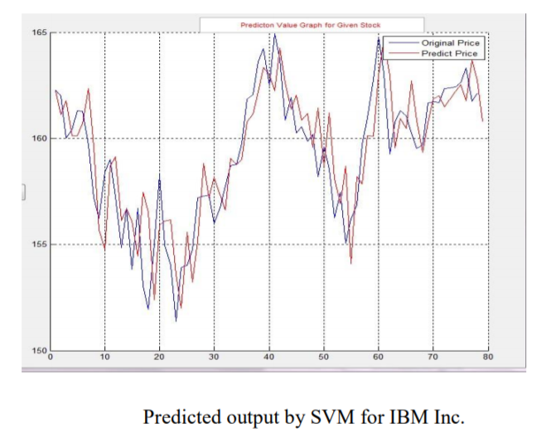
Stock Market Prediction using Support Vector Machines
Implements the structural risk minimization principle where many traditional neural network models had implemented the empirical risk minimization principle.
SVM searches to minimize an upper bound of generalization error.

Slide 13
Comparison
A significant advantage of SVMs is that whilst ANNs can suffer from multiple local minima, the solution to an SVM is global and unique ANN try to minimize classification errors while SVM make classification error in order to minimize the overall error in test data.
ANNs often overfit if training goes on too long.
If you want to use a kernel SVM you have to guess the kernel. However, ANNs are universal approximators with only guessing to be done is the width (approximation accuracy) and height (approximation efficiency)
While GA gives us association rules for high profit, in itself, the prediction from GA isn’t much use without prior knowledge of trading strategies and desirable conditions in the stock relations

Slide 14
Comparing prediction accuracy from various models.
In the Models considered in the study of Machine learning aided stock prediction Project, we concluded that the accuracy that we received from the ANN Model is 50%, while SVMs have given the accuracy of about 60%.
Unlike conventional statistical and neural network methods, the SVM approach does not attempt to control model complexity by keeping the number of features small.
In the study we conclude that SVM holds the most promising results and scope of development, we can sought to create a better model as a part of the final project to predict Stock Market prices while improving the feature selection and data.

Slide 15
Comparing prediction accuracy from various models.
ANN often exhibits inconsistent and unpredictable performance on noisy data.
ANNs are quite accurate when the data does not have sudden variations, but in stock market we encounter just the opposite of this.

Slide 16
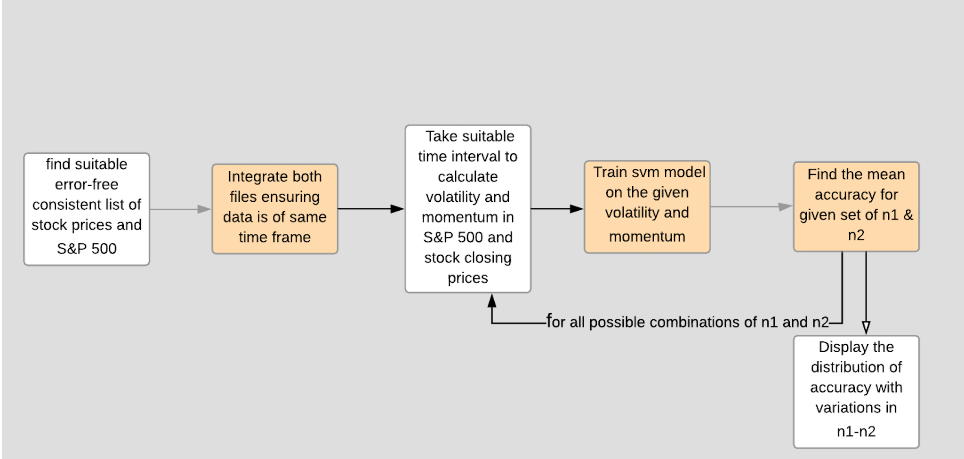
Flow of work

Slide 17
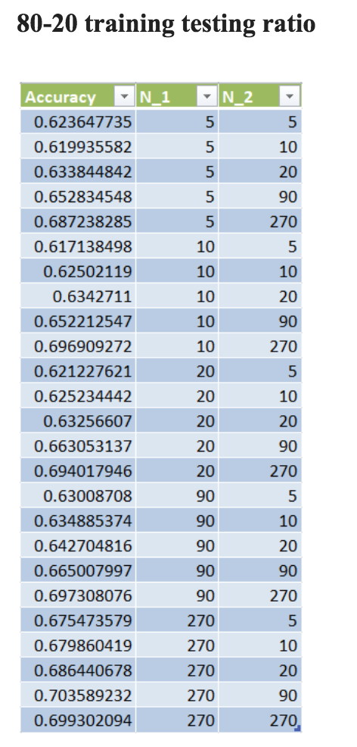
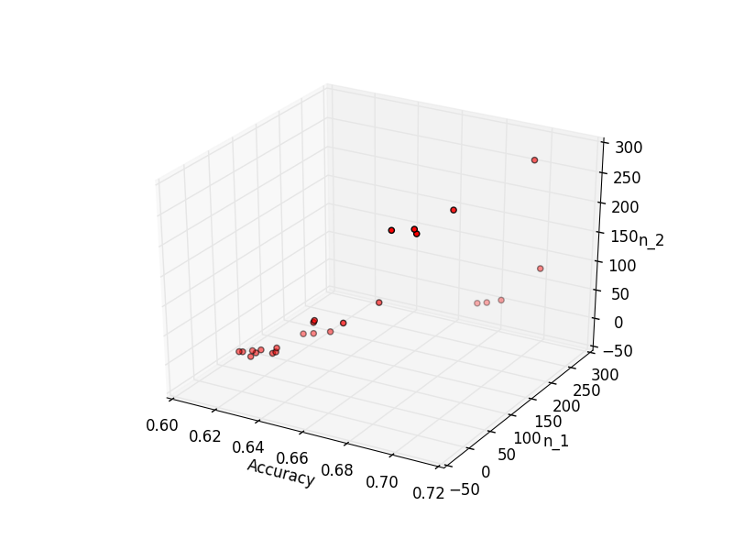
Results
Average accuracy for 80-20 training
testing ratio :: 0.702691924227318

Slide 18
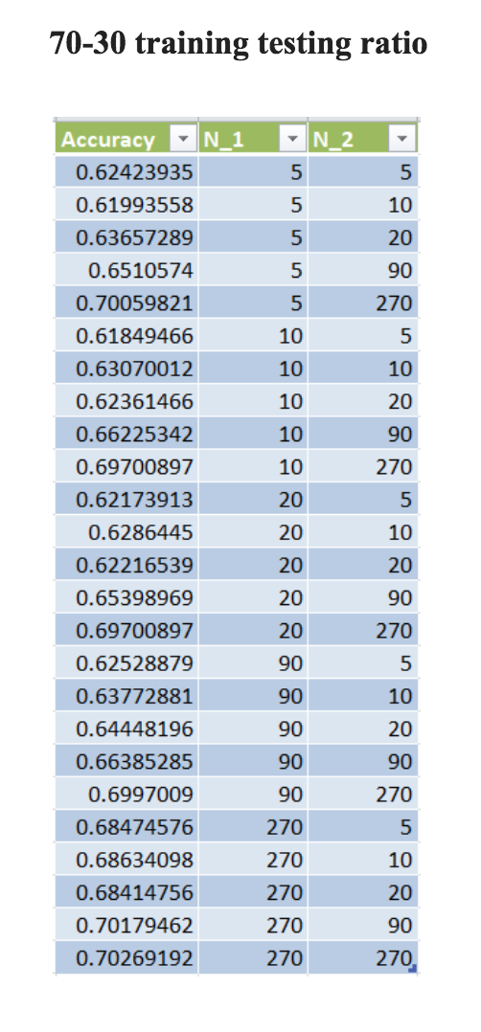
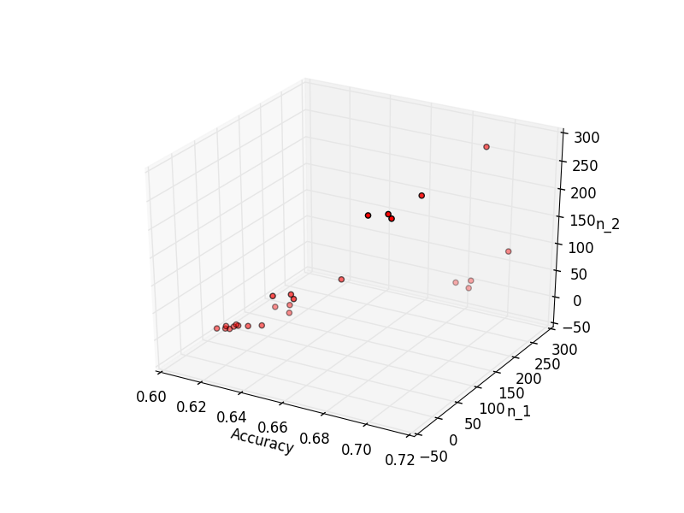
Results
Average accuracy for 70-30 training
testing ratio :: 0.6546427962830927

Slide 19
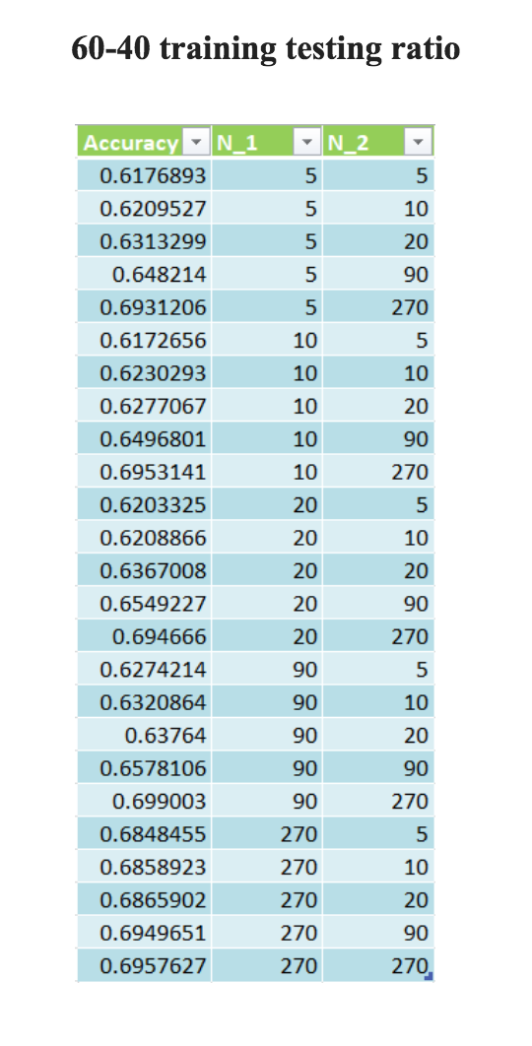
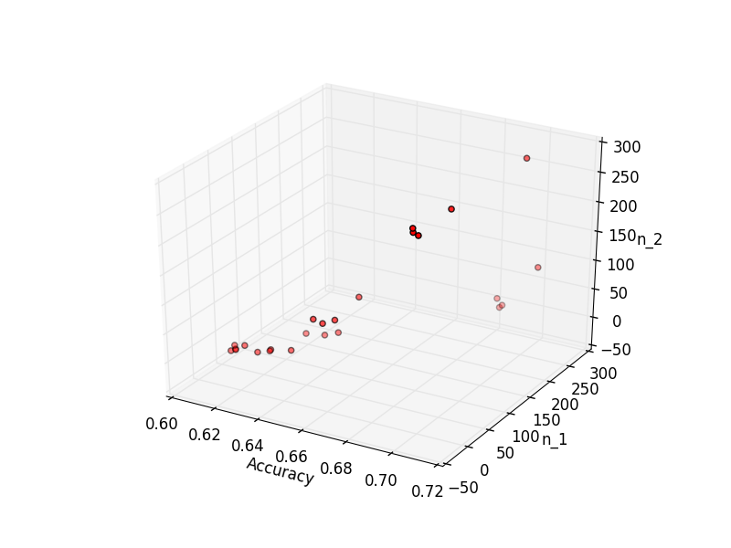
Results
Average accuracy for 60-40 training
testing ratio :: 0.6527294411993994

Slide 20
Conclusion
With this study we have found a suitable model for implementation of the Stock Market Prediction.
The model has produced improved accuracies.
We were able to correlate the accuracy of predictions with the time frame of study to draw useful conclusion about the general behavior of the market.

Slide 21
Future Deliverables
This information can be used to improve the model by taking into account more features like stock popularity in the news, equity ratio and assets into consideration.
We can also use this information as background to simulate high frequency trading and create a profitable model.
We can further extend this study by looking at the intra-day trading in addition to the adjusted closing price.
Individual stocks often have price swings that last only for a couple minutes, which an intra-day model can analyze, and then use to predict price direction in the next few seconds or minutes to earn profits.

Slide 22
THANK YOU
Group Members : -
Mudit Rathore: ICM2015502
Ayushi Asthana: ITM2015004
Ishani Mishra: IWM2015008
Rakesh Reddy: IRM2015007
Anshula Gahrana: IIM2015005

